Slide 1
SHIFT REGISTERS

Slide 2
S-1 | SLO-1 | Registers and Types of Registers- Serial In - Serial Out, Serial In - Parallel out
 | SLO-2 | Parallel In - Serial Out, Parallel In - Parallel Out

Slide 3
Registers
A collection of flip-flops taken as an entity.
Function: Hold information within a digital system so that it is available to the logic elements during the computing process.
Each combination of stored information is known as the state or content of the register.
Shift register: Registers that are capable of moving information upon the occurrence of a clock-signal.
Unidirectional
Bidirectional
Two basic ways in which information can be entered/outputted
Parallel: All 0/1 symbols handled simultaneously. Require as many lines as symbols being transferred.
Serial: Involves the symbol-by-symbol availability of information in a time sequence.
Four possible ways registers can transfer information:
Serial-in/serial-out
Serial-in/parallel-out
Parallel-in/parallel-out
Parallel-in/serial-out

Slide 4
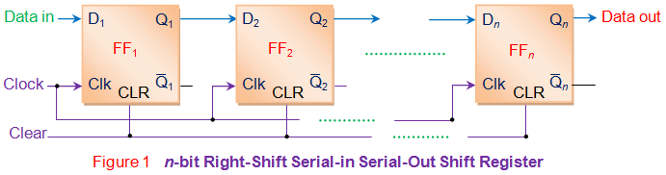
Serial in Serial out (SISO) Shift Register - serial right shift register Reference:https://www.electrical4u.com/serial-in-serial-out-siso-shift-register/
Serial In Serial Out (SISO) shift registers are a kind of shift registers where both data loading as well as data retrieval to/from the shift register occurs in serial-mode. Figure 1 shows a n-bit synchronous SISO shift register sensitive to positive edge of the clock pulse.
The data word which is to be stored is fed bit-by-bit at the input of the first flip-flop.
It is seen that the inputs of all other flip-flops (except the first flip-flop FF₁) are driven by the outputs of the preceding ones say for example, the input of FF₂ is driven by the output of FF₁. At last the data stored within the register is obtained at the output pin of the n^{th} flip-flop in serial-fashion.
Initially all the flip-flops in the register are cleared by applying high on their clear pins. Next the input data word is fed serially to FF₁.

Slide 5
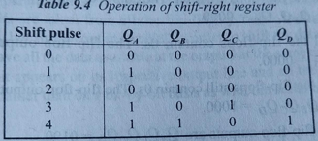
SISO Continued…
This causes the bit appearing at the D₁ pin (B₁) to be stored into FF₁ as soon as the first leading edge of the clock appears. Further at the second clock tick, B₁ gets stored into FF₂ while a new bit enters into FF₁ (B₂).
This kind of shift in data bits continues for every rising edge of the clock pulse. This indicates that for every single clock pulse the data within the register moves towards right by a single bit. Thus the design shown in Figure 1 is regarded as a right-shift SISO shift register.
Example let the 4 bit binary number 1101 be entered into the register, beginning with the right most bit. (Note: Here QA , QB, QC and QD is Q1,Q2, Q3,Q4) Reference: Digital Circuits Design – S Salivahanan S Arivazhagan

Slide 6
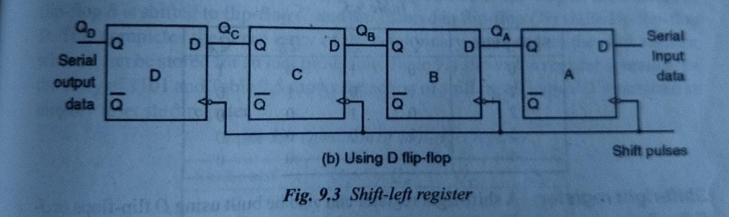
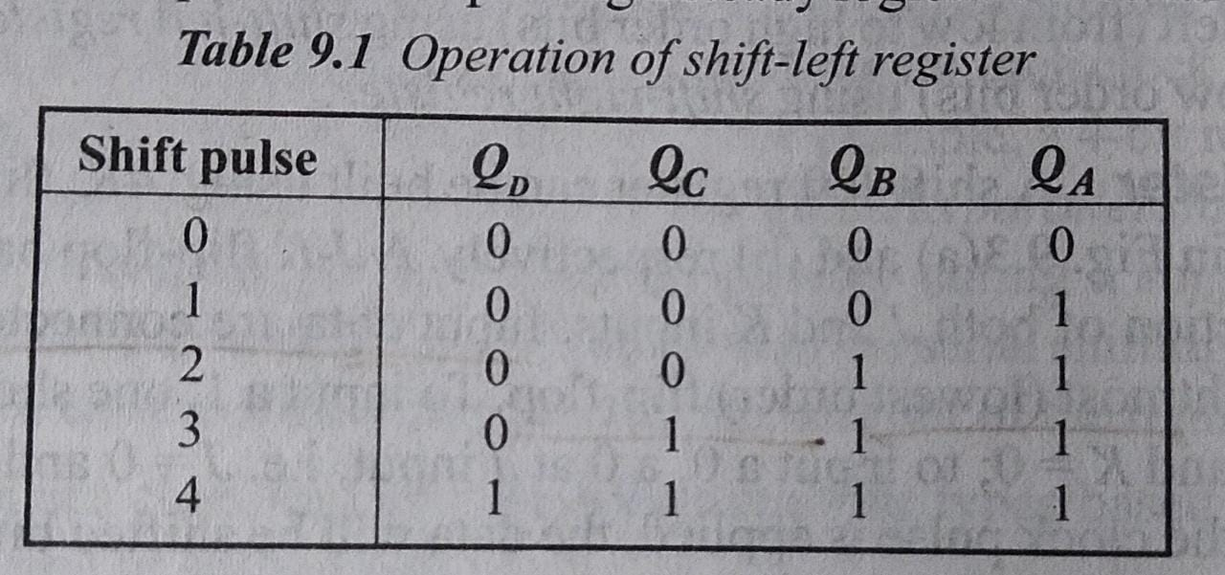
Serial left shift register Reference: Digital Circuits Design – S Salivahanan S Arivazhagan

Slide 7
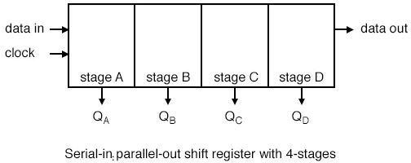
SIPO Reference:https://www.allaboutcircuits.com/textbook/digital/chpt-12/serial-in-parallel-out-shift-register/
If four data bits are shifted in by four clock pulses via a single wire at data-in, below, the data becomes available simultaneously on the four Outputs Q_{A} to Q_{D} after the fourth clock pulse.
The practical application of the serial-in, parallel-out shift register is to convert data from serial format on a single wire to parallel format on multiple wires.

Slide 8
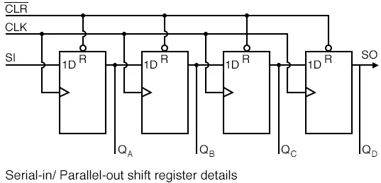
The above details of the serial-in, parallel-out shift register are fairly simple. It looks like a serial-in, serial-out shift register with taps added to each stage output.
Serial data shifts in at SI (Serial Input). After a number of clocks equal to the number of stages, the first data bit in appears at SO (Q_{D}) in the above figure.
In general, there is no SO pin. The last stage (Q_{D} above) serves as SO and is cascaded to the next package if it exists.

Slide 9
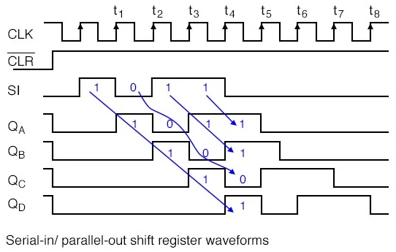
SIPO Waveforms

Slide 10
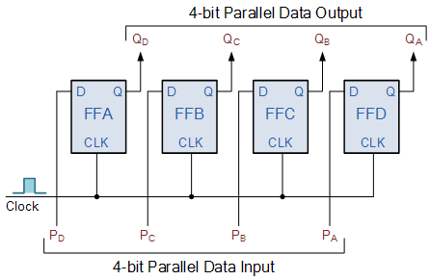
PIPO(Parallel in Parallel Out) Reference: https://www.electronics-tutorials.ws/sequential/seq_5.html
This type of shift register also acts as a temporary storage device or as a time delay device similar to the SISO configuration above.
The data is presented in a parallel format to the parallel input pins P_{A} to P_{D} and then transferred together directly to their respective output pins Q_{A} to Q_{D} by the same clock pulse
Then one clock pulse loads and unloads the register. This arrangement for parallel loading and unloading is shown.

Slide 11
Parallel In - Serial Out Shift Registers
The circuit uses D flip-flops and NAND gates for entering data (ie writing) to the register.
D0, D1, D2 and D3 are the parallel inputs, where D0 is the most significant bit and D3 is the least significant bit.
To write data in, the mode control line is taken to LOW and the data is clocked in.
The data can be shifted when the mode control line is HIGH as SHIFT is active high.

Slide 12
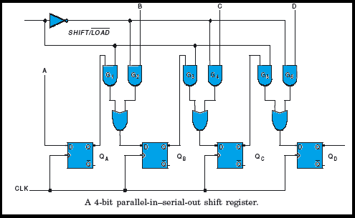
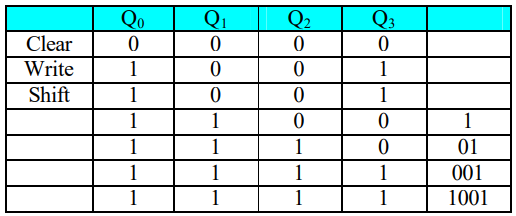

Slide 13
S-2 | SLO-1 | Universal Shift Register
 | SLO-2 | Applications of Shift Registers

Slide 14
Universal Shift Register
The universal shift register can be defined as “The register which can be used to shift the data in both the directions like left, right and can load parallel data as well”.
This register can perform three types of operations, stated below.
Parallel loading
Shifting left
Shifting right.

Slide 15
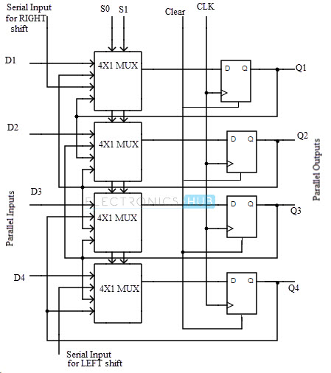
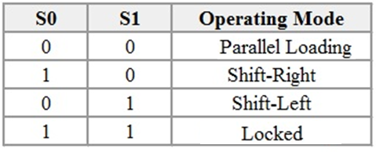

Slide 16
Application of Shift Register
Delay line
Serial to parallel converter
Parallel to serial converter
Shift register counter
Sequence generator

